Slide 1











A short presentation of Sibiu and of The High School of Art
Project Erasmus + KA2 - „Notes of Europe”

Slide 2

Welcome to Romania
Welcome to Sibiu

Slide 3
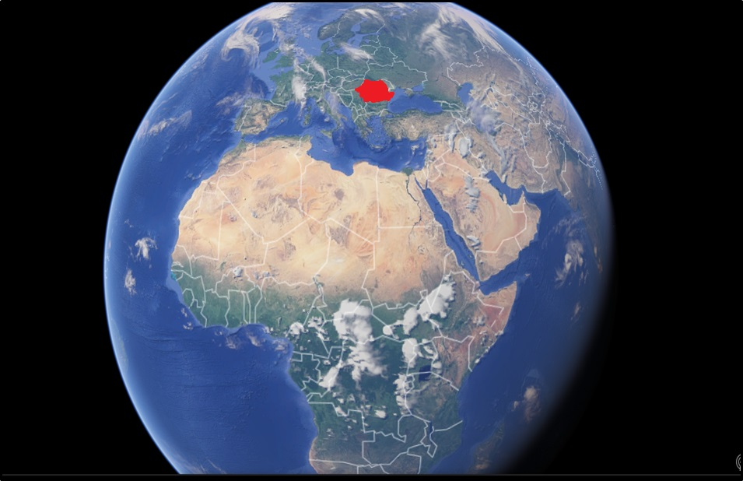
ROMANIA’S LOCATION ON THE GLOBE

Slide 4
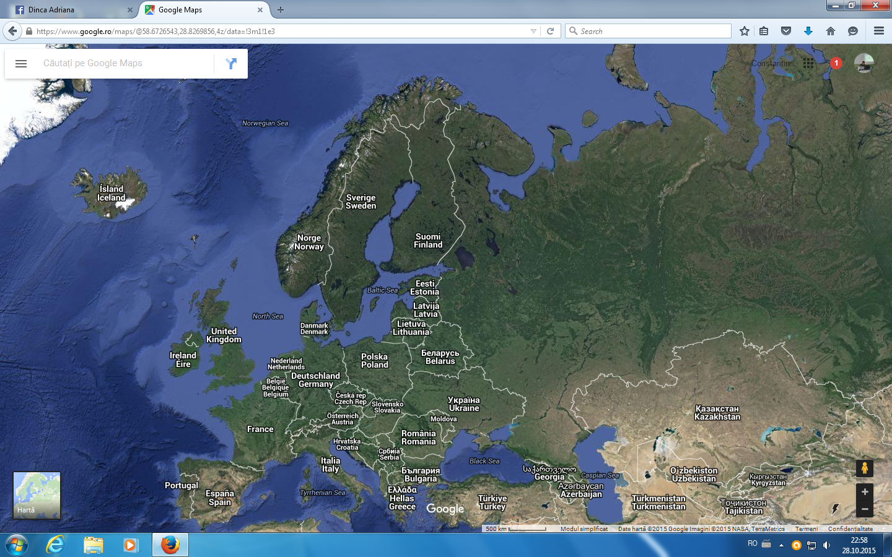

ROMANIA – a country situated on the South-East of Central Europe

Slide 5
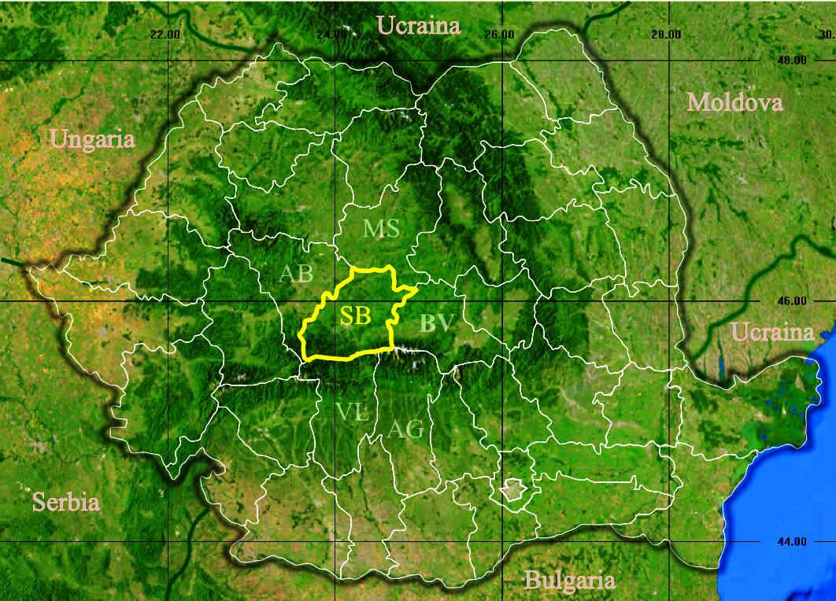
THE LOCATION OF SIBIU COUNTY IN ROMANIA

Slide 6
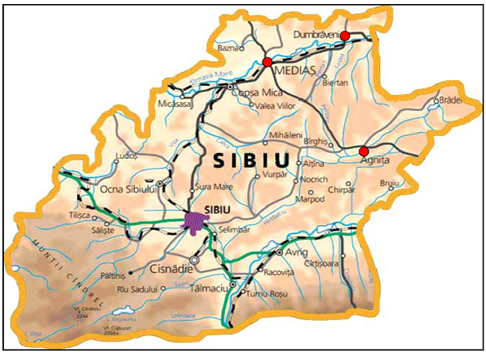
SIBIU COUNTY
Is situated in the centre of Romania, in the historical area called Transylvania, at 45°47' northern latitudine and 24°05' eastern longitudine on Cibin river;
It is one of the most important cities in Transylvania, with a remarkable potential of economical development, advantaged also by its position on the Four Paneuropean Corridor and beneffiting from a modern international airport;
With 147.245 permanenț inhabitants (2011) and 30.000 temporary ones, especially students, Sibiu is the largest town in the county.
Local community consists of different ethnical groups. The great majority of population is represented by Romanians (94%) who live together with Germans, descendants of Saxons’ colonists who emigrated in the 12th century from Luxemburg, Lorena and Alsatia. There are also Hungarians, Romani and Jewish, all of them contributing, through their particular cultural influences to the city life. The religious life is characterised by the same diversity. Alongside with de Orthodox people in Sibiu, the ones who practise freely their religion are Reformed, Roman Catholics, Greek-Catholics, Evangelical Lutherans and Neoprotestants.

Slide 7
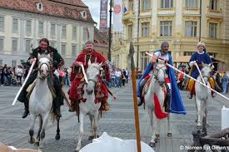
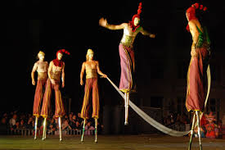
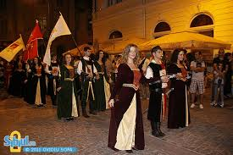
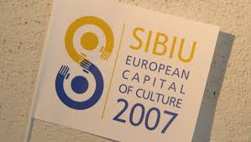
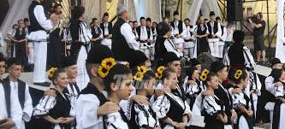
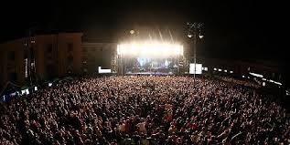
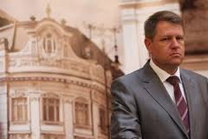
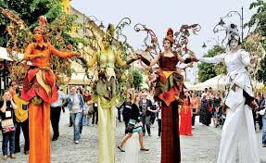


Cultural
Sibiu

Slide 8
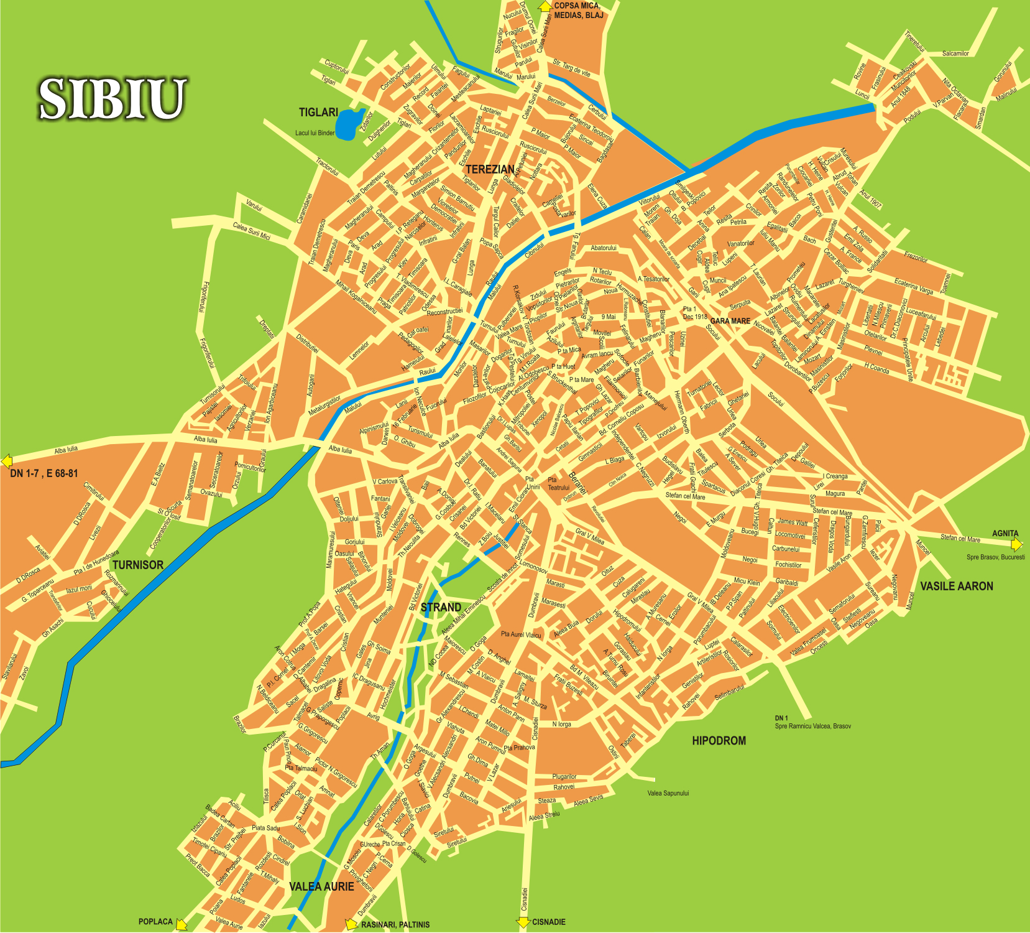

High School of Art

Slide 9
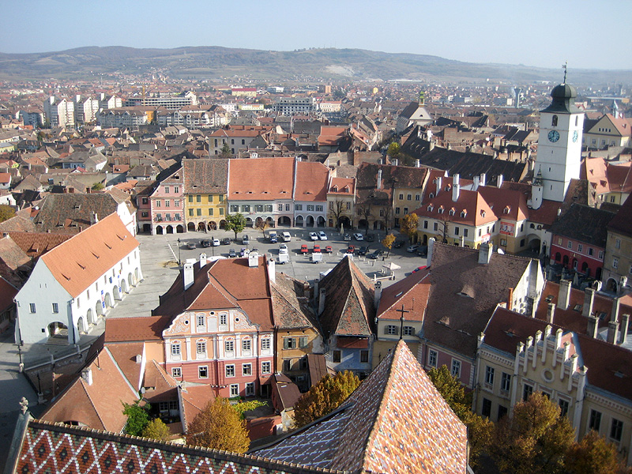
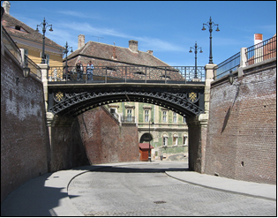
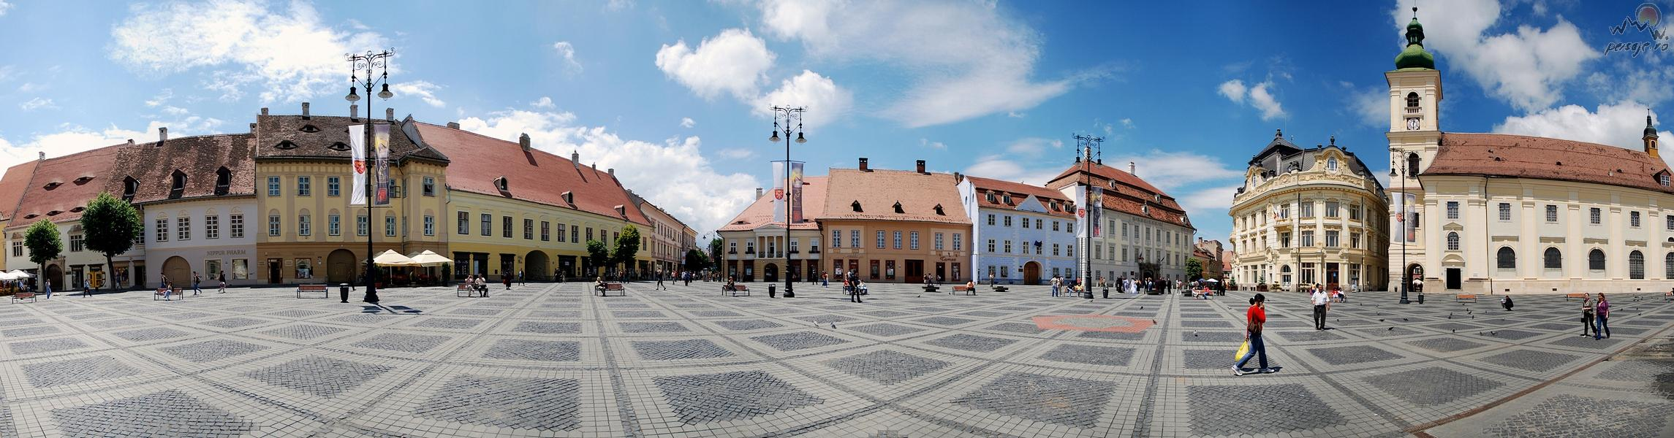
Counsel
Tour
Cooper’s House
Bridge of Lies
The Arts House
Luxemburg House
THE LARGE SQUARE
Haller House
Moringer
House
Brukenthal
Palace
“St. Trinity” Roman-
Catholic Church
City Hall

Slide 10
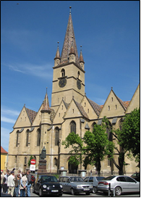
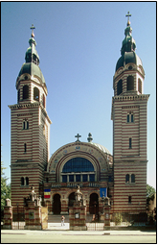
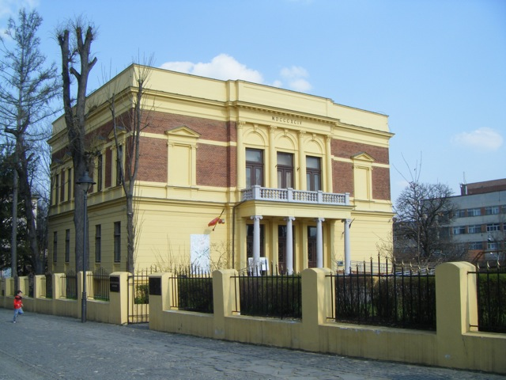
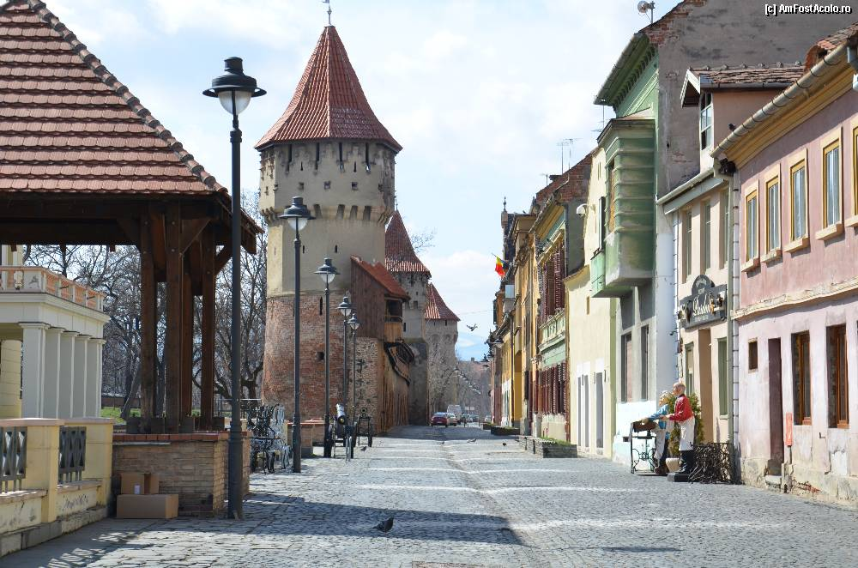
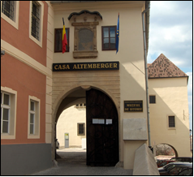
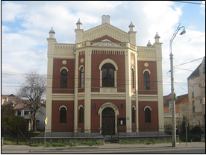
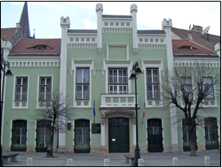
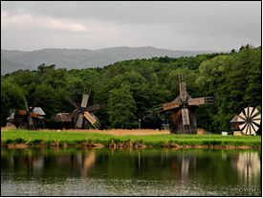
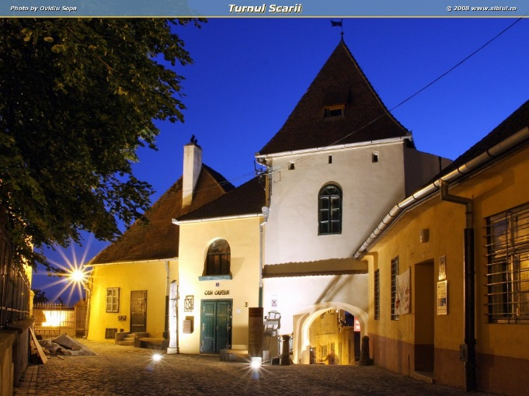
SIBIU
Orthodox Metropolitan Cathedral
“St. Trinity”
T
O
U
R
I
S
T
I
C
“St. Mary” Evangelical Church
Natural History Museum
Citadel Street
History Museum
The Synagogue
“Franz Binder” Museum
Traditional Art Museum
“Astra”
The Stairs Tower

Slide 11
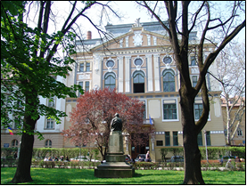
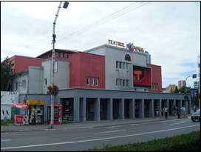
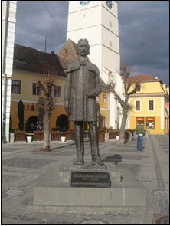
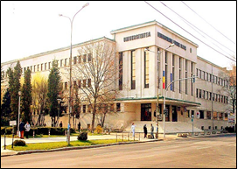
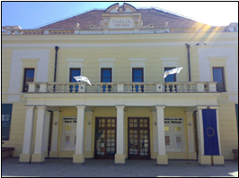
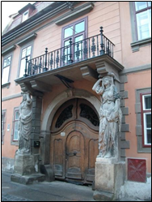
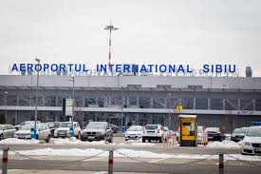
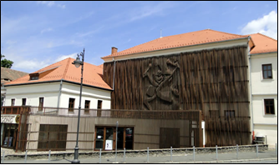
“Radu Stanca”National Theatre
Astra Library
Gheorghe Lazar’s Statue
“Lucian Blaga” University–
Faculty of History, Letters and Art
Thalia Hall, The State Phylarmonic of Sibiu
SIBIU
The House with Cariatides
“Gong” Theatre for Children
and Youngsters

Slide 12
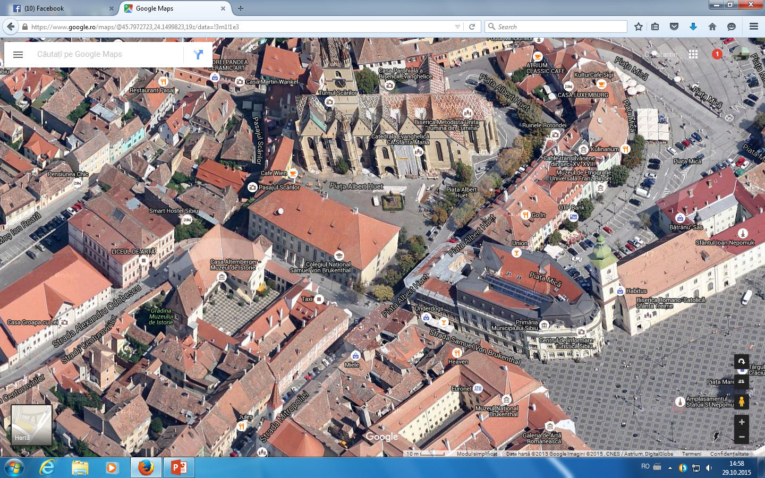
We are here

Slide 13
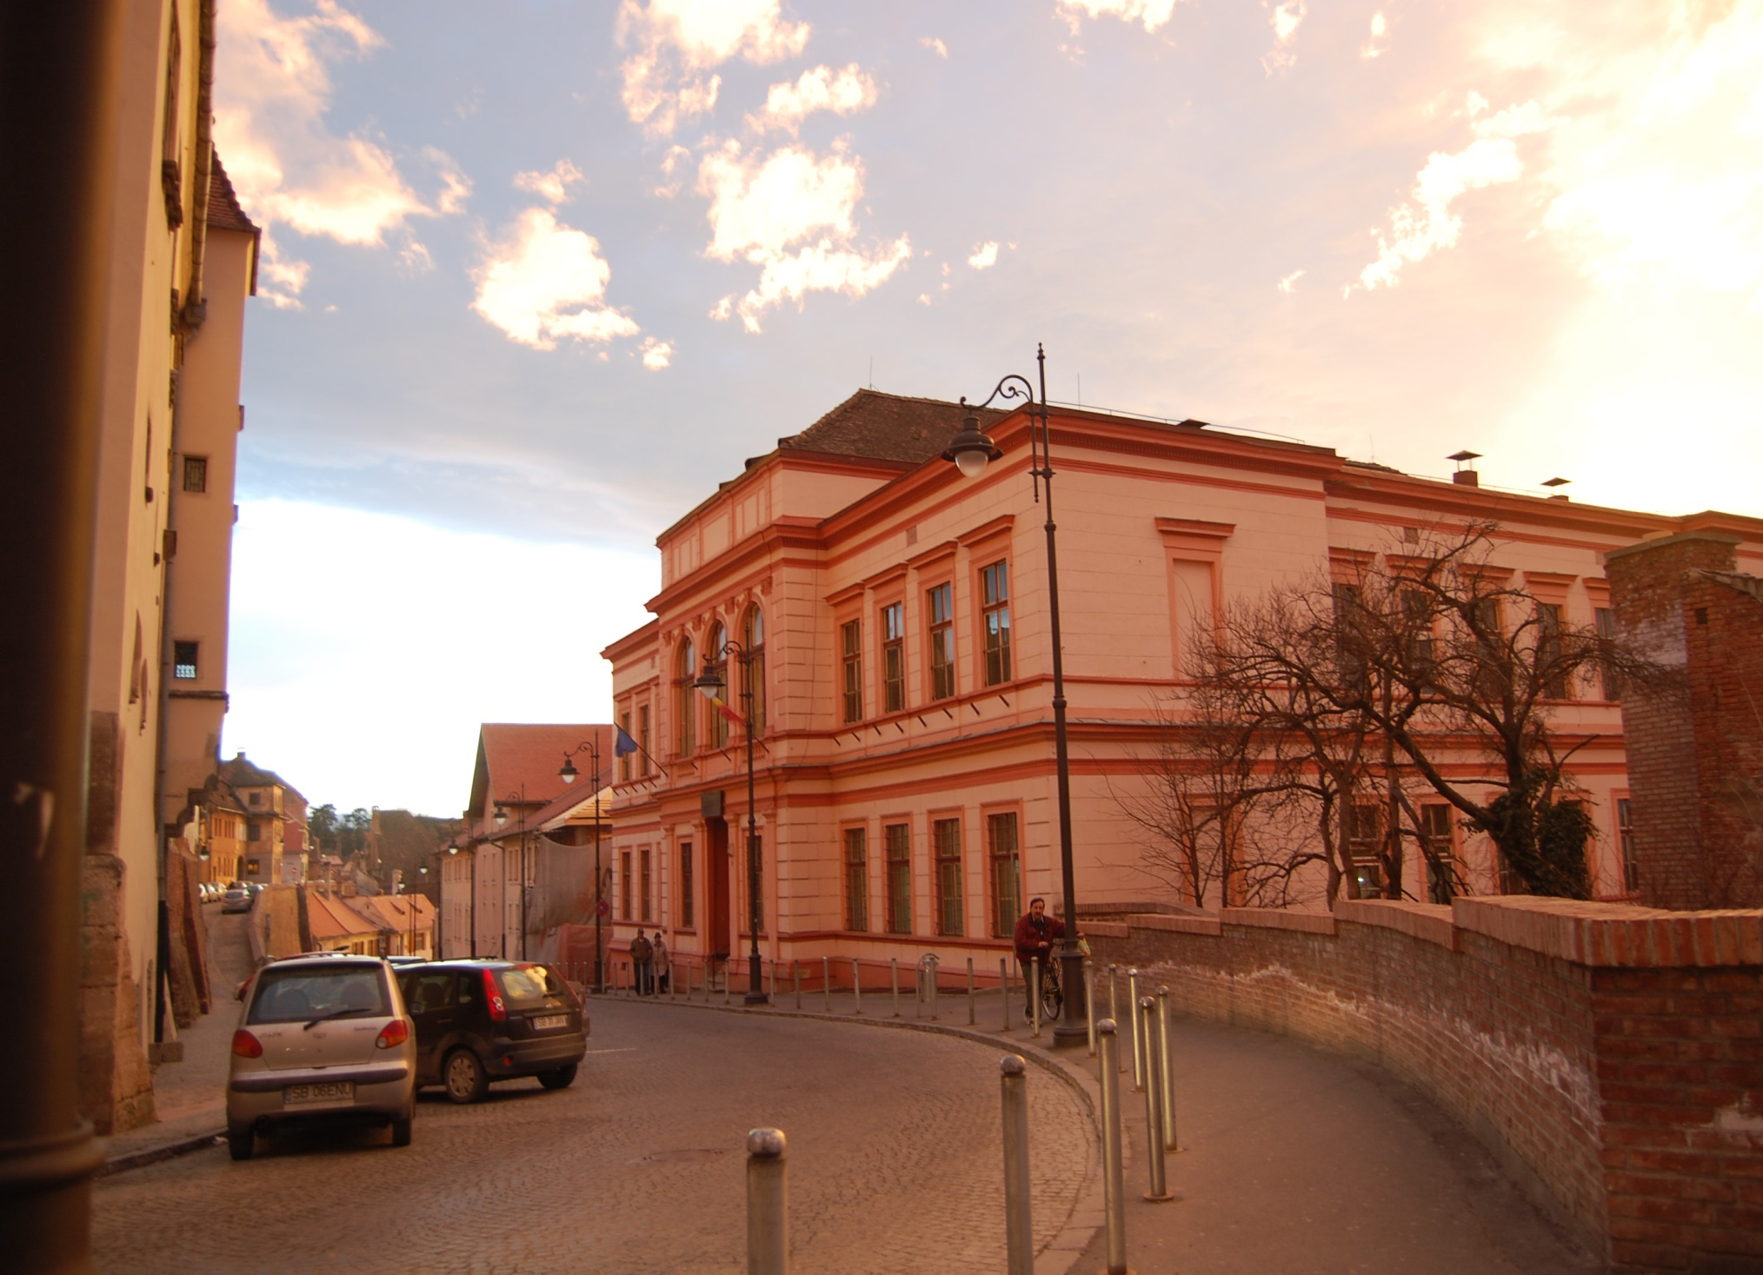


L
HIGH SCHOOL OF ART SIBIU
550195,TEL.0269211458, FAX:0269213149
E-mail:office@licartasibiu.ro

Slide 14
The school mission
The artistic education offer brought by The High School of Art Sibiu to the local and county community has represented not only an educational alternative of training through art for a large category of students, but also one for achieving national and international artistic performances.
The high school is proud of its graduates who are, at present, famous performers, artists and valuable teachers in the field of visual arts and music, but also the ones who followed other fields like: medicine, philology, law, journalism, architecture, etc).

Slide 15
Our school motto :
“A school open to art, with art, through art”

Slide 16
A Short History of High School of Art Sibiu
1st September 1957- was founded “The School of Art” Sibiu whose name changed in “7 Years Music School”; it functioned as a Music Section with an external school programme
1st September 1964 - was created The Visual Arts and Music Integrated Programme for V-VIII grades; the external school music programme continued for I-IV grades
June 1965- first exam session for 9th grade – music field
The school name changed into “High School of Music and Visual Arts Sibiu”
June 1966- first exam session for 9th grade – visual arts field
July 1969 – first graduate students – music field
July 1970 – graduates – both music and visual arts
July 1978 – the last graduate students – music and visual arts of High School of Music and Visual Arts Sibiu
September 1978- High School of Music and Visual Arts Sibiu changed into “Secondary School of Art” and later became “Secondary School no 14”, with an integrated and external music programme for I-VIII grads and an integrated programme for visual arts I-VIII grades

Slide 17
July 1981 – the last graduate students – music and visual arts, within Pedagogical High School Sibiu
Septembrie 1990- The high school got the name of High School of Art Sibiu
1990-2003 – there was also The Choreography Section
2003-2010 – High School of Art Sibiu has an integrated education and also an external music programme for Preparatory Class up to 8th grade; there is also integrated education for visual arts V-VIII grades and high school level for IX-XII grades, both Music and Visual Arts.
2010-present –High School of Art Sibiu has integrated music education for Prep-XII grades and visual arts for V-XII grades

Slide 18
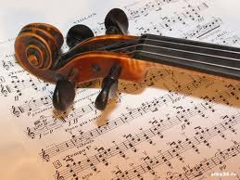

The Educational Offer
Our Institution is part of the artistic vocational field, with music and visual arts specializations.
It is structured on 3 educational cycles : primary (Preparatory – IV grades), secondary (V – VIII grades) and high school (IX – XII grades).
The music field is addressed to students from Prep. – XII grades aged between
6 and 18
instrumental section (Prep – XII grades) piano, violin, viola, cello, double bass, flaut, clarinet, bassoon, horn, panpipe, percussion and trumpet
classical canto section (IX – XII grades)
theoretical section (IX – XII grades)
Visual arts field is addressed to students from V-XII grades, having high school sections:
Painting, sculpture, graphics

Slide 19
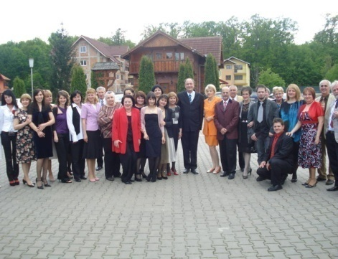
SCHOOL SITUATION AT PRESENT
Number of classes: 21; number of students: 480
Educational Staff:
1 - headmaster
5 – primary school teachers
27 – general culture teachers
9 – visual arts teachers
51 – music teachers
Auxiliary staff: 7 people
1 secretary, 1 accountant, 1 administrator, 1 librarian, 1 IT person, 2 assistant music masters
Non-educational staff: 5 people
3 cleaners, 1 maintenance mechanic, 1 guardian

Slide 20

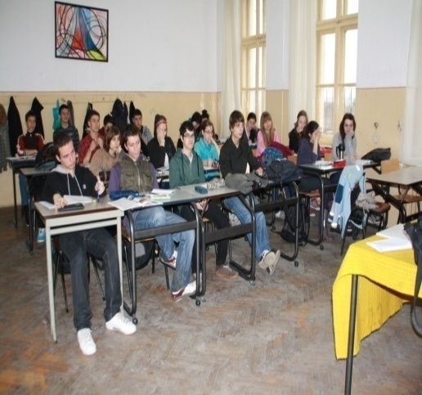
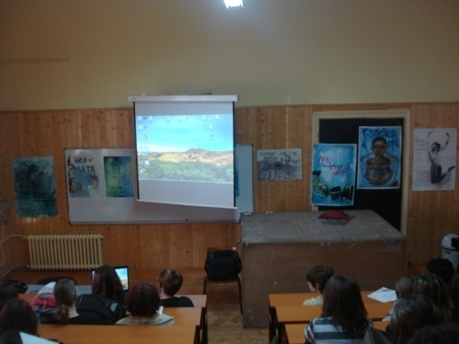
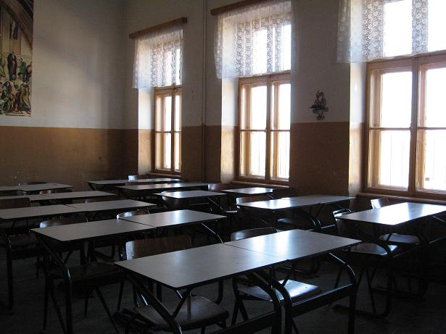
Facilities
The High School of Art is placed in one building on four levels (basement, semi-basement, ground floor, first floor), there are totally :
20 classrooms
4 workshops
2 sculpture workshops
1 graphics workshop
1 painting workshop
14 music study rooms
1 IT lab
1 sports field of 400mp
1 gym

Slide 21
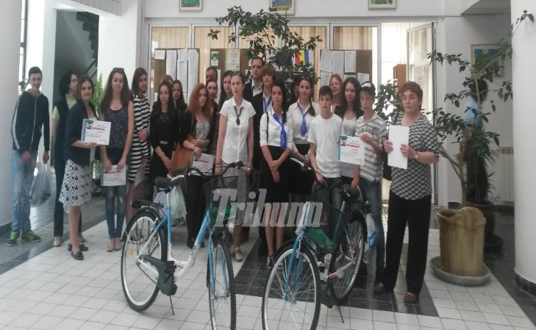
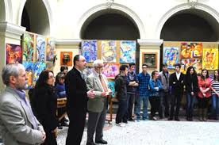
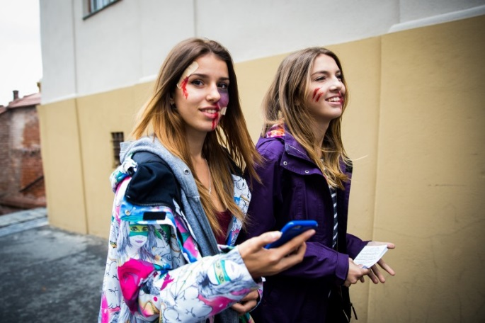
Out-of-school activities
The school activity is completed by a great diversity of out-of-school activities such as competitons, recitals, exhibitions, national olympiads, educational projects, partnerships, ecological activities, collaboration protocols, between our institution and others such as: banks, libraries, Visual Artists Union, “Gong” Theatre for Children and Youngsters, museums, churches, police, hospitals, etc)
These activities bring us satisfactions not only through their prizes but also through the raise of school prestige al local, county and national level.

Slide 22
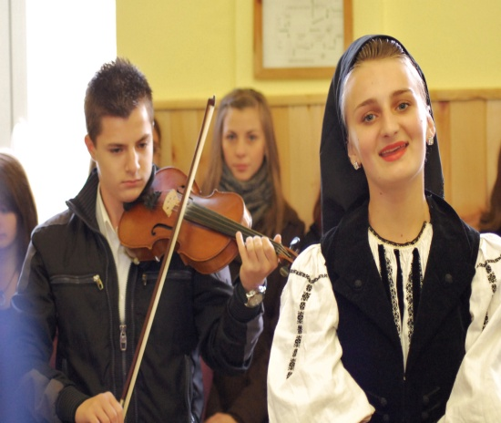
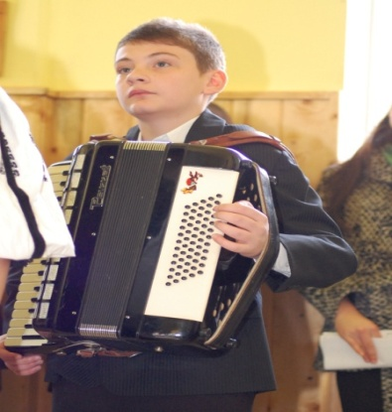
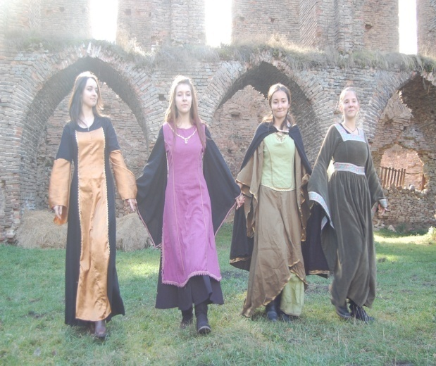
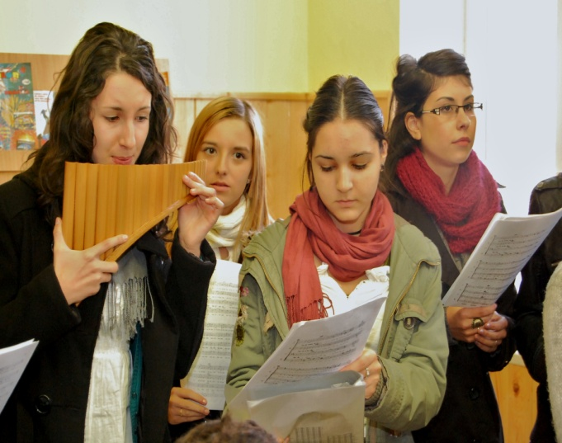
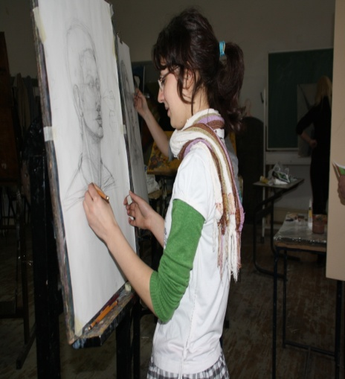
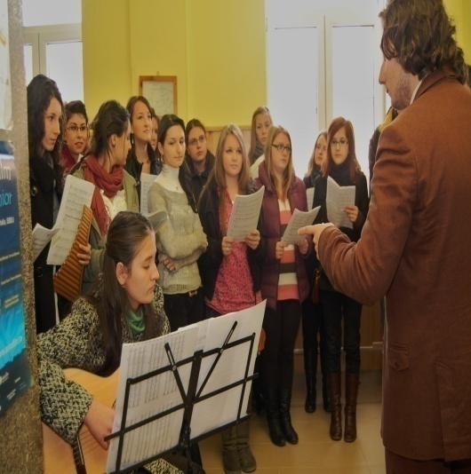
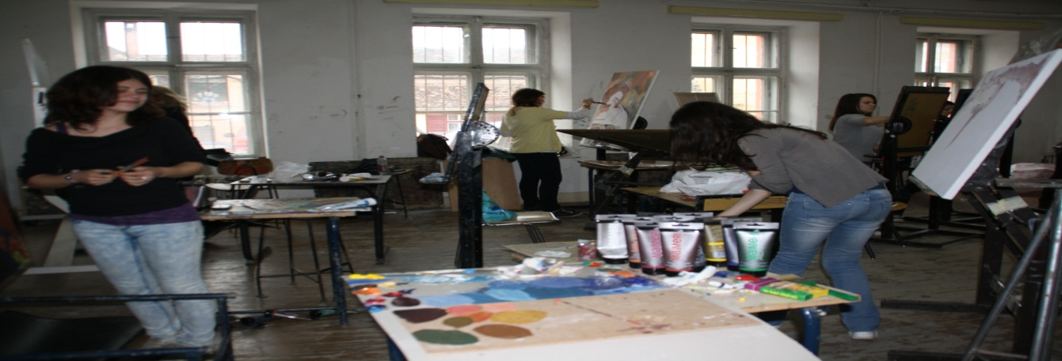

Slide 23





Out-of-school Activities

Slide 24
“ Hans Hermann”
Visual Arts Contest
Coordonator teacher: Dan Călin Băban
“Hans Hermann” National Visual Arts Contest is a cultural-artistic manifestation which is addressed to IX–XII grades students from art vocational education and V–VIII grades students from mass education, having the following sections:
PAINTING ( MONUMENTAL Project, EASEL Painting)
GRAPHICS
DECORATIVE ARTS ( TEXTILE AND CERAMICS)
SCULPTURE
ART HISTORY
There were assessed over 400 students’ works from the counties involved in the project.
The first contest edition was in 2008.

Slide 25




Hagiu Raisa
1st Prize - Painting
Herciu Nicolae
1st Prize-Painting
Pop Sebastian,
3rd Prize- Graphics
Buştiuc Vlad Special Prize
There were four editions with stimulating themes, carefully chosen:
“The City- geometry and sesitivity ”- 2008
“Gothic ” - 2009
“ The City - Tradition, Spirituality , Symbol ” -2010
”The Baroque – or the world as a show”- 2011

Slide 26


“TIMOTEI POPOVICI” NATIONAL CONTEST OF INSTRUMENTAL PERFORMANCE
STRINGGED INSTRUMENTS
The first edition took place 13 years ago ( in 2002)
At the latest edition, over 100 students from 17 high schools all over the country took part.
This contest represets the condition of early preparation for the future generations of musicians and those who will not make art their profession will get the sensitivity and the educational pulse so necessary and yet so rare.

Slide 27







Slide 28






PAINTING EXHIBITION - 22nd March 2012 class XI B, Painting Field
Coordinator teacher: Eugen Dornescu
CHILDREN GAME

Slide 29





Educational Project
“The Costume from Baroque to Neo-Gothic”, Brukenthal Palace, 2009
Coordinator teacher: Anca Serfözö

Slide 30







Educaţional Project
Fairies, elves, dragons, mermaids in Brukenthal Palace, 2012
Coordinator teacher: Anca Serfözö

Slide 31
PLATO Project
Coordinator teacher: Carmen Droc
1993- A Collaboration between students from High School of Art Sibiu (ballet section) and Hans- Leinberger Gymnasium Landshut as an exchange of students, during 4 years
1998 – It turned into an educational school project- Friendship Without Borders/ Kooperation ohne Grenzen and other schools became partners: Albania, Europaische Schule- Munchen, “Gheorghe Lazăr” National College Sibiu and “Octavian Goga” National College Sibiu
2000- INTERNATIONAL PROJECT, joining The European School from Karlsruhe Germany, (which withdrew in 2010), also Odskerreds- Gymnasium- Asnaes ,Danmark and Gymnasium Sacre Coeur-Pressbaum , Austria

Slide 32



PLATO Project

Slide 33



Activities within the project
Workshops
Socialization
between students
Shows
Exhibitions with students’ works
Meetings with the towns
officials

Slide 34








Educational Project coordinated by Dan Călin Băban
10 concerts of Sibiu Art High School students upheld at Thalia Hall in Sibiu

Slide 35







Coordinator teacher:
Adriana Dincă

Slide 36
RITUALS and CEREMONIES
School - starting year Festivity
Celebration of 1st December
Christmas Carols
Winter Carnival
Freshmen’s Ball
Coming –of-age Ball
Key Handing by the 12th Grade
School -ending year Festivity

Slide 37





Prizes and Awards
Numerous prizes and awards received by the high school students to national and international competitions make The High School of Art Sibiu an artistic educational institution of prestige among high schools with the same field in the country.

Slide 38


Achievements:
40 prizes at national olympiads;
80 prizes and awards at different national contests

Slide 39




First Prize at National Olympiad of Visual Arts,Architecture and Art History, Arad, 2015
Coordinator teacher: Marcela Froman
Diana Amalia Varga
Ioana Daniela Tocoaie

Slide 40


Coordinator teacher Emese Kálmán
The trophy of the contest
“Sibiu- Musical Capital, 2015”,
instrumental section
Mordăşan Raul
National Olympiad of Classical Music, inter-county level, instrumental performance, piano section 2015
- Bistriţa
Ghera Alexia- First Prize
Trînbiţaş Alexandru- 2nd Prize
Mordăşan Raul - 2nd Prize

Slide 41
THE VALUES PROMOTED BY THE WHOLE EDUCATIONAL STAFF ARE: quality and professionalism respect will strength aspiration faith commitment attitude

Slide 42


58 years of existence
Foto: Diana Chirilă
“I won’t be an ordinary man, because I have the right to be extraordinary“
Peter O’ Toole

